Slide 1
College of Western Idaho SWDV 210 Introduction to Server Side Programming
Lab – Strings and Numbers

Slide 2
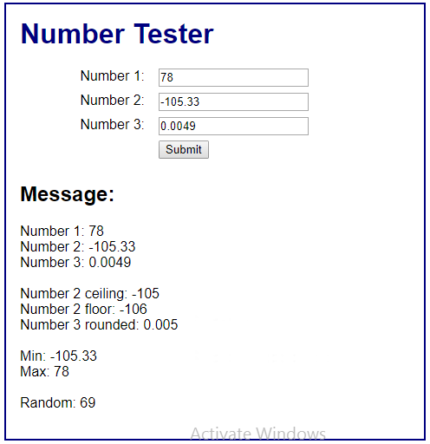
Lab – Strings and Numbers
Complete Exercise 9-2 on pages 292
Post the link to your application in BB under Daily Labs, Wk3Day2 & submit
Expected output:

